Slide 1
BUAD 5082
Machine Learning II
Ridge Regression and the Lasso
(ISLR, Chapter 6 Continued)
Notes:
1
1

Slide 2
Agenda
We next consider ways in which the simple linear model can be improved upon by replacing plain least squares fitting with some alternative fitting procedures. In particular, we will address the following:
Shrinkage Methods
Fitting a model involving all p predictors, but shrinking the estimated coefficients towards zero relative to the least squares estimates (also known as regularization) to reduce variance at the expense of bias.

Slide 3
Shrinkage methods

Slide 4
Shrinkage Methods
The subset selection methods described in previous sessions involved using least squares to fit a linear model that contains a subset of the predictors.
As an alternative, we can fit a model containing all p predictors using a technique that constrains or regularizes the coefficient estimates, or equivalently, that shrinks the coefficient estimates towards zero.
It may not be immediately obvious why such a constraint should improve the fit, but it turns out that shrinking the coefficient estimates can significantly reduce their variance.
The two best-known techniques for shrinking the regression coefficients towards zero are ridge regression and the lasso.

Slide 5
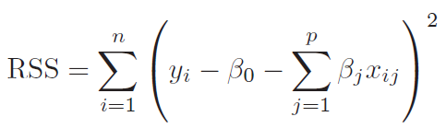
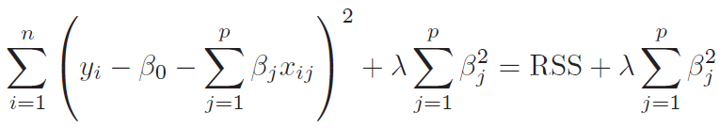
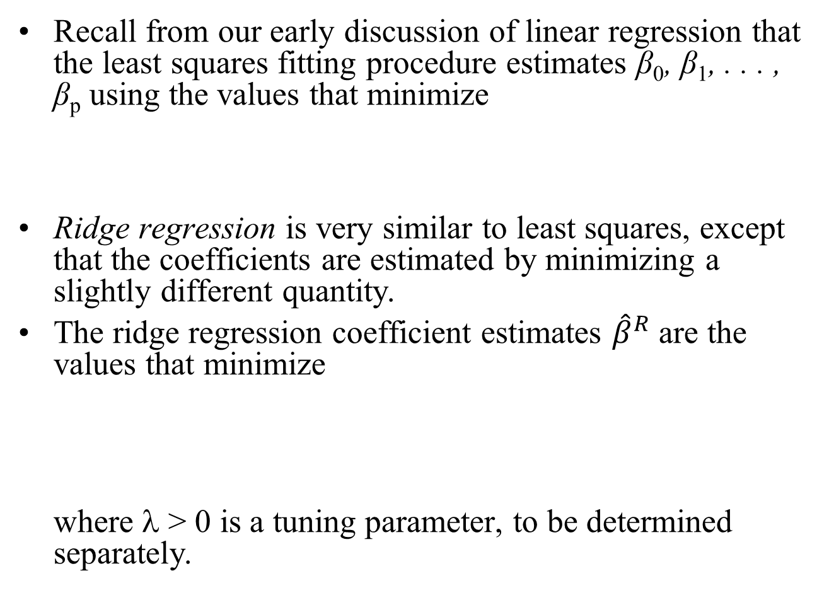
Ridge Regression
Recall from our early discussion of linear regression that the least squares fitting procedure estimates β₀, β₁, . . . , β_{p} using the values that minimize
Ridge regression is very similar to least squares, except that the coefficients are estimated by minimizing a slightly different quantity.
The ridge regression coefficient estimates ${\hat{β}}^{R}$ are the values that minimize where λ > 0 is a tuning parameter, to be determined separately.

Slide 6
Ridge Regression
This expression trades off two different criteria:
As with least squares, ridge regression seeks coefficient estimates that fit the data well, by making the RSS small.
However, the second term, called a shrinkage penalty, is small when β₁, . . . , β_{p} are close to zero, and so it has the effect of shrinking the estimates of β_{j} towards zero.
The tuning parameter λ serves to control the relative impact of these two terms on the regression coefficient estimates:
When λ = 0, the penalty term has no effect, and ridge regression will produce the least squares estimates.
However, as λ→∞, the impact of the shrinkage penalty grows, and the ridge regression coefficient estimates will approach zero.

Slide 7
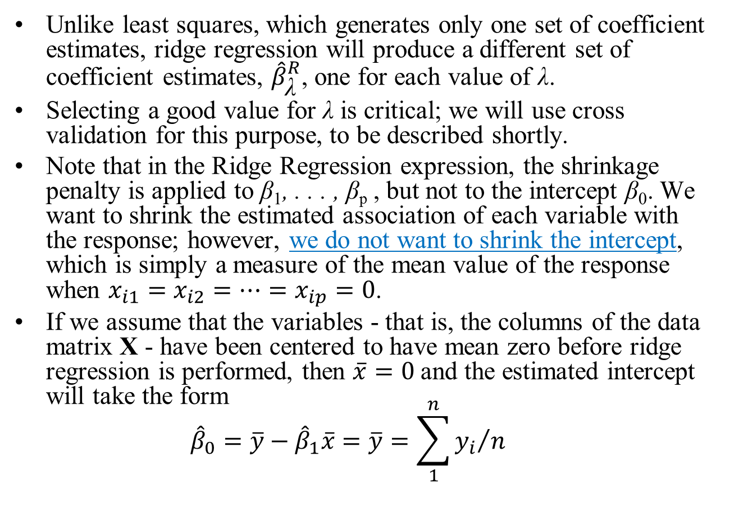
Ridge Regression
Unlike least squares, which generates only one set of coefficient estimates, ridge regression will produce a different set of coefficient estimates, ${\hat{β}}_{\text{λ}}^{R}$, one for each value of λ.
Selecting a good value for λ is critical; we will use cross validation for this purpose, to be described shortly.
Note that in the Ridge Regression expression, the shrinkage penalty is applied to β₁, . . . , β_{p} , but not to the intercept β₀. We want to shrink the estimated association of each variable with the response; however, we do not want to shrink the intercept, which is simply a measure of the mean value of the response when $x_{i1}=x_{i2}=…=x_{ip}=0$.
If we assume that the variables - that is, the columns of the data matrix X - have been centered to have mean zero before ridge regression is performed, then $\overline{x}=0$and the estimated intercept will take the form ${\hat{β}}_{0}=\overline{y}−{\hat{β}}_{1}\overline{x}=\overline{y}=\sum_{1}^{n}{{y_{i}}/n}$

Slide 8
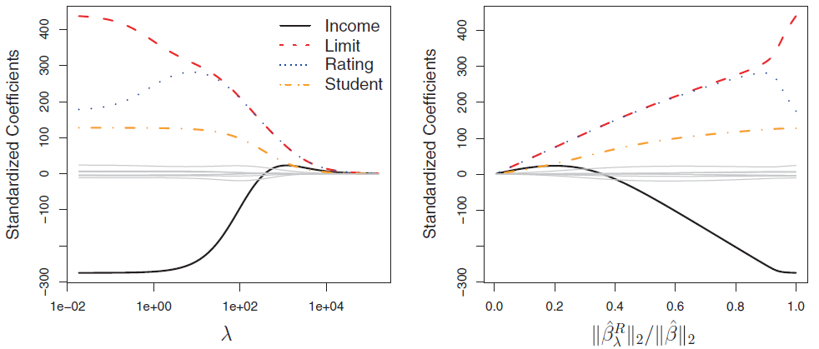
Ridge Regression: Example
In the figure above, the standardized ridge regression coefficient estimates for the Credit data set are displayed.
Each curve corresponds to the standardized ridge regression coefficient estimate for one of the ten variables, plotted as a function of λ.
At the extreme left-hand side of the plot, λ is essentially zero, and so the corresponding ridge coefficient estimates are the same as the usual least squares estimates.
But as λ increases, the ridge coefficient estimates shrink towards zero. When λ is extremely large, then all of the ridge coefficient estimates are basically zero; this corresponds to the null model that contains no predictors.

Slide 9
Ridge Regression: Example
In this plot, the income, limit, rating, and student variables are displayed in distinct colors, since these variables tend to have by far the largest coefficient estimates.
While the ridge coefficient estimates tend to decrease in aggregate as λ increases, individual coefficients, such as rating and income, may occasionally increase as λ increases.

Slide 10
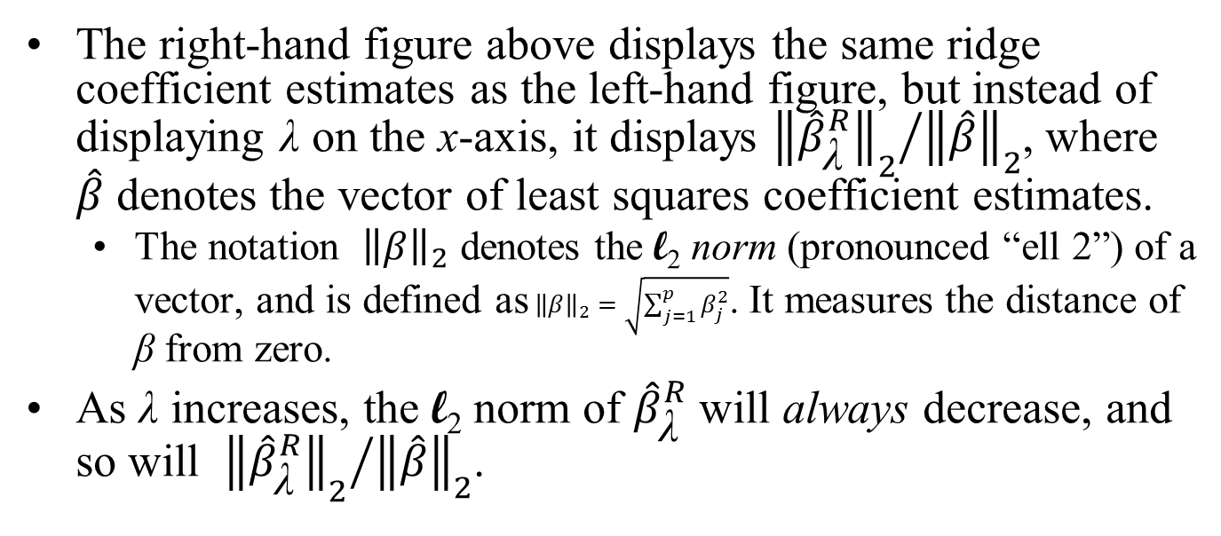
Ridge Regression: Example
The right-hand figure above displays the same ridge coefficient estimates as the left-hand figure, but instead of displaying λ on the x-axis, it displays ${{\left\|{\hat{β}}_{\text{λ}}^{R}\right\|}_{2}}/{{\left\|\hat{β}\right\|}_{2}}$, where $\hat{β}$ denotes the vector of least squares coefficient estimates.
The notation ${\left\|β\right\|}_{2}$ denotes the l₂ norm (pronounced “ell 2”) of a vector, and is defined as${\left\|β\right\|}_{2}=\sqrt{\sum_{j=1}^{p}{β_{j}^{2}}}$. It measures the distance of β from zero.
As λ increases, the l₂ norm of ${\hat{β}}_{\text{λ}}^{R}$ will always decrease, and so will ${{\left\|{\hat{β}}_{\text{λ}}^{R}\right\|}_{2}}/{{\left\|\hat{β}\right\|}_{2}}$.

Slide 11
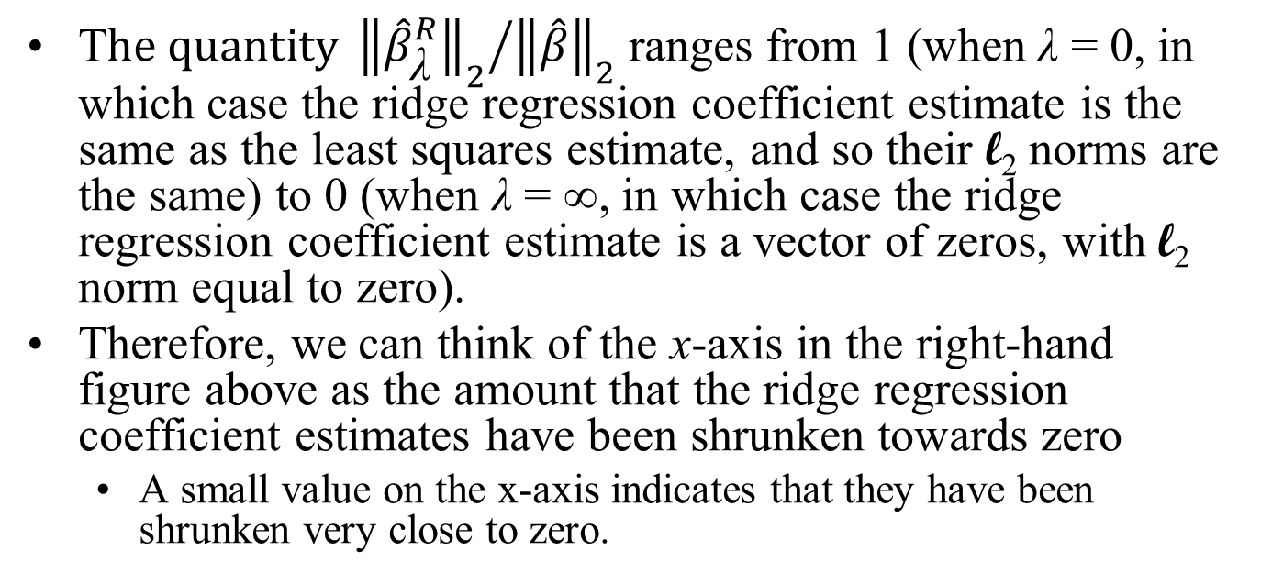
Ridge Regression: Example
T$he quantity {{\left\|{\hat{β}}_{\text{λ}}^{R}\right\|}_{2}}/{{\left\|\hat{β}\right\|}_{2}}$ ranges from 1 (when λ = 0, in which case the ridge regression coefficient estimate is the same as the least squares estimate, and so their l₂ norms are the same) to 0 (when λ = ∞, in which case the ridge regression coefficient estimate is a vector of zeros, with l₂ norm equal to zero).
Therefore, we can think of the x-axis in the right-hand figure above as the amount that the ridge regression coefficient estimates have been shrunken towards zero
A small value on the x-axis indicates that they have been shrunken very close to zero.

Slide 12
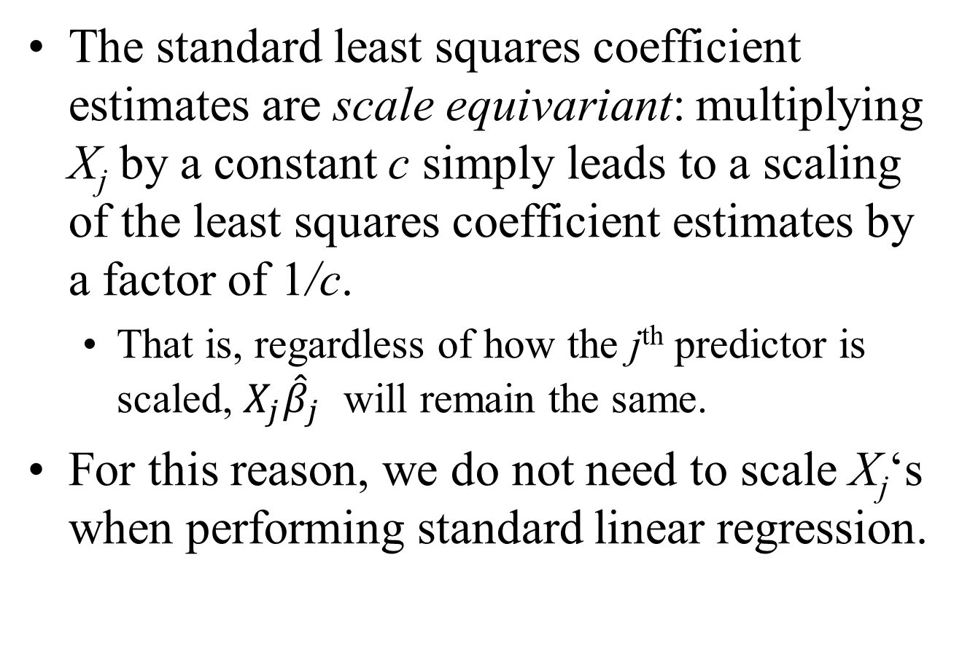
Ridge Regression: Example
The standard least squares coefficient estimates are scale equivariant: multiplying X_{j} by a constant c simply leads to a scaling of the least squares coefficient estimates by a factor of 1/c.
That is, regardless of how the j^{th} predictor is scaled, $X_{j}{\hat{β}}_{j}$ will remain the same.
For this reason, we do not need to scale X_{j}‘s when performing standard linear regression.

Slide 13
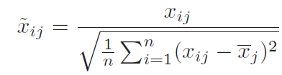
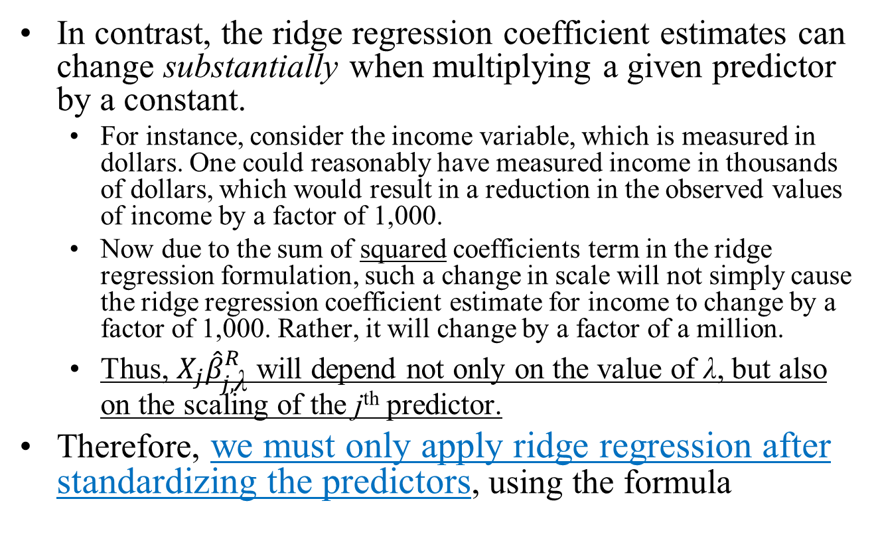
Ridge Regression: Example
In contrast, the ridge regression coefficient estimates can change substantially when multiplying a given predictor by a constant.
For instance, consider the income variable, which is measured in dollars. One could reasonably have measured income in thousands of dollars, which would result in a reduction in the observed values of income by a factor of 1,000.
Now due to the sum of squared coefficients term in the ridge regression formulation, such a change in scale will not simply cause the ridge regression coefficient estimate for income to change by a factor of 1,000. Rather, it will change by a factor of a million.
Thus, $X_{j}{\hat{β}}_{j,\text{λ}}^{R}$ will depend not only on the value of λ, but also on the scaling of the j^{th} predictor.
Therefore, we must only apply ridge regression after standardizing the predictors, using the formula
This is just the standard deviation of the column

Slide 14
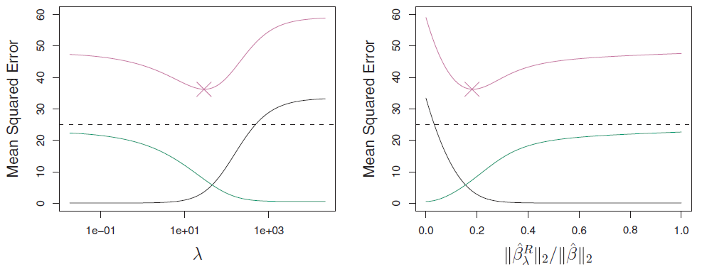
Why Does Ridge Regression Improve Over Least Squares?
Bias
Variance
Ridge regression’s advantage over least squares is rooted in the bias-variance trade-off.
As λ increases, the flexibility of the ridge regression fit decreases, leading to decreased variance
This is illustrated in the figure above using a simulated data set containing p = 45 predictors and n = 50 observations.
At the least squares coefficient estimates, which correspond to ridge regression with λ = 0, the variance is high but there is low bias.
But as λ increases, the shrinkage of the ridge coefficient estimates leads to a substantial reduction in the variance of the predictions, at the expense of a slight increase in bias.
Recall that the test mean squared error (MSE), plotted in purple, is a function of the variance plus the squared bias.

Slide 15
Why Does Ridge Regression Improve Over Least Squares?
Bias
Variance
For values of λ up to about 10, the variance decreases rapidly, with very little increase in bias. Consequently, the MSE drops considerably as λ increases from 0 to 10.
Beyond this point, the decrease in variance due to increasing λ slows, and the shrinkage on the coefficients causes them to be significantly underestimated, resulting in a large increase in the bias.
The minimum MSE is achieved at approximately λ = 30.

Slide 16
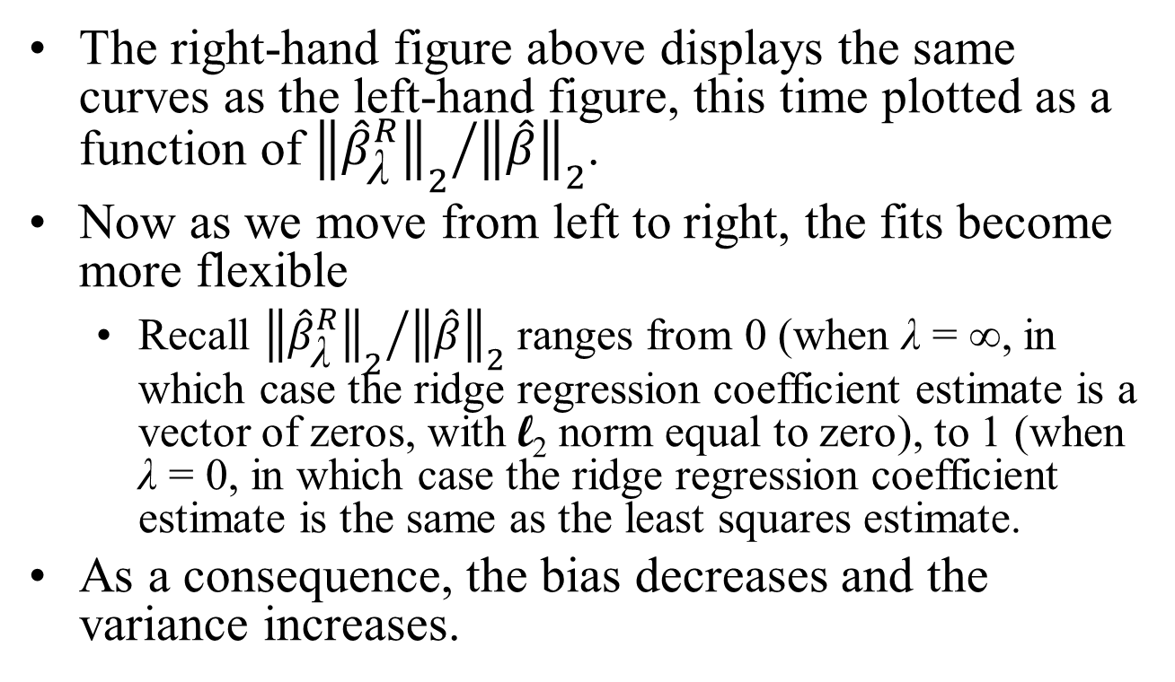
Why Does Ridge Regression Improve Over Least Squares?
Bias
Variance
The right-hand figure above displays the same curves as the left-hand figure, this time plotted as a function of ${{\left\|{\hat{β}}_{\text{λ}}^{R}\right\|}_{2}}/{{\left\|\hat{β}\right\|}_{2}}$.
Now as we move from left to right, the fits become more flexible
Recall ${{\left\|{\hat{β}}_{\text{λ}}^{R}\right\|}_{2}}/{{\left\|\hat{β}\right\|}_{2}}$ ranges from 0 (when λ = ∞, in which case the ridge regression coefficient estimate is a vector of zeros, with l₂ norm equal to zero), to 1 (when λ = 0, in which case the ridge regression coefficient estimate is the same as the least squares estimate.
As a consequence, the bias decreases and the variance increases.

Slide 17
Ridge Regression
In general, in situations where the relationship between the response and the predictors is close to linear, the least squares estimates will have low bias but may have high variance.
This means that a small change in the training data can cause a large change in the least squares coefficient estimates.
In particular, when the number of variables p is almost as large as the number of observations n, as in the example above (n = 50, p = 45), the least squares estimates will be extremely variable.
And if p > n, then the least squares estimates do not even have a unique solution, whereas ridge regression can still perform well by trading off a small increase in bias for a large decrease in variance.
Hence, ridge regression works best in situations where the least squares estimates have high variance.

Slide 18
Ridge Regression
Ridge regression also has substantial computational advantages over best subset selection, which requires searching through 2^{p} models.
As we discussed previously, even for moderate values of p, such a search can be computationally infeasible.
In contrast, for any fixed value of λ, ridge regression only fits a single model, and the model-fitting procedure can be performed quite quickly.
In fact, one can show that the computations required to solve the ridge regression formula, simultaneously for all values of λ, are almost identical to those for fitting a model using least squares.
A final point: ridge regression never eliminates predictors entirely, and is therefore not a subset selection method. The process of shrinking the coefficient estimates is instead called Regularization.

Slide 19
See the Ridge Regression section in RidgeRegressionAndTheLasso.R

Slide 20
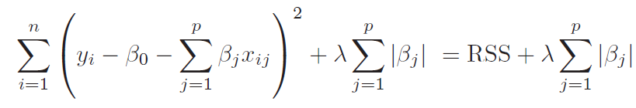
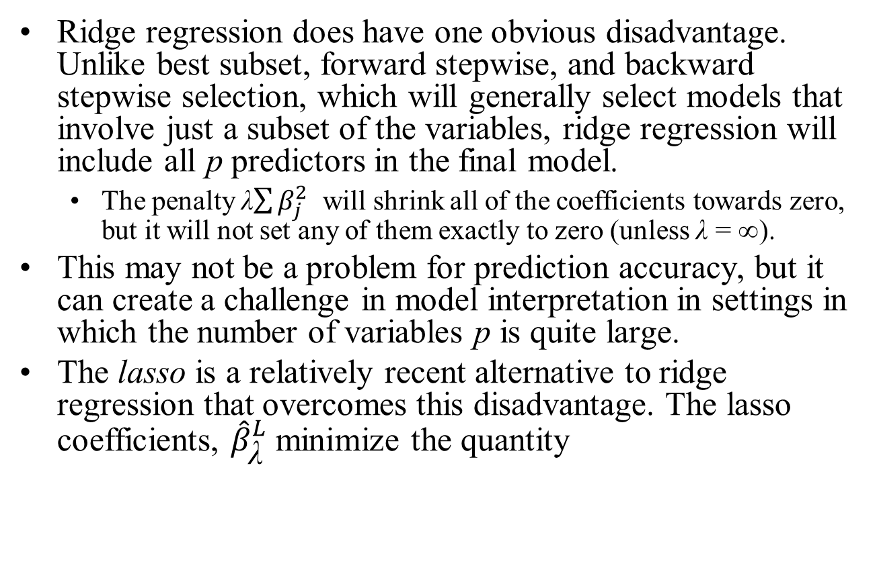
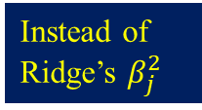
The Lasso
Ridge regression does have one obvious disadvantage. Unlike best subset, forward stepwise, and backward stepwise selection, which will generally select models that involve just a subset of the variables, ridge regression will include all p predictors in the final model.
The penalty λ$\sum{β_{j}^{2}}$ will shrink all of the coefficients towards zero, but it will not set any of them exactly to zero (unless λ = ∞).
This may not be a problem for prediction accuracy, but it can create a challenge in model interpretation in settings in which the number of variables p is quite large.
The lasso is a relatively recent alternative to ridge regression that overcomes this disadvantage. The lasso coefficients, ${\hat{β}}_{\text{λ}}^{L}$ minimize the quantity
Instead of Ridge’s $β_{j}^{2}$

Slide 21
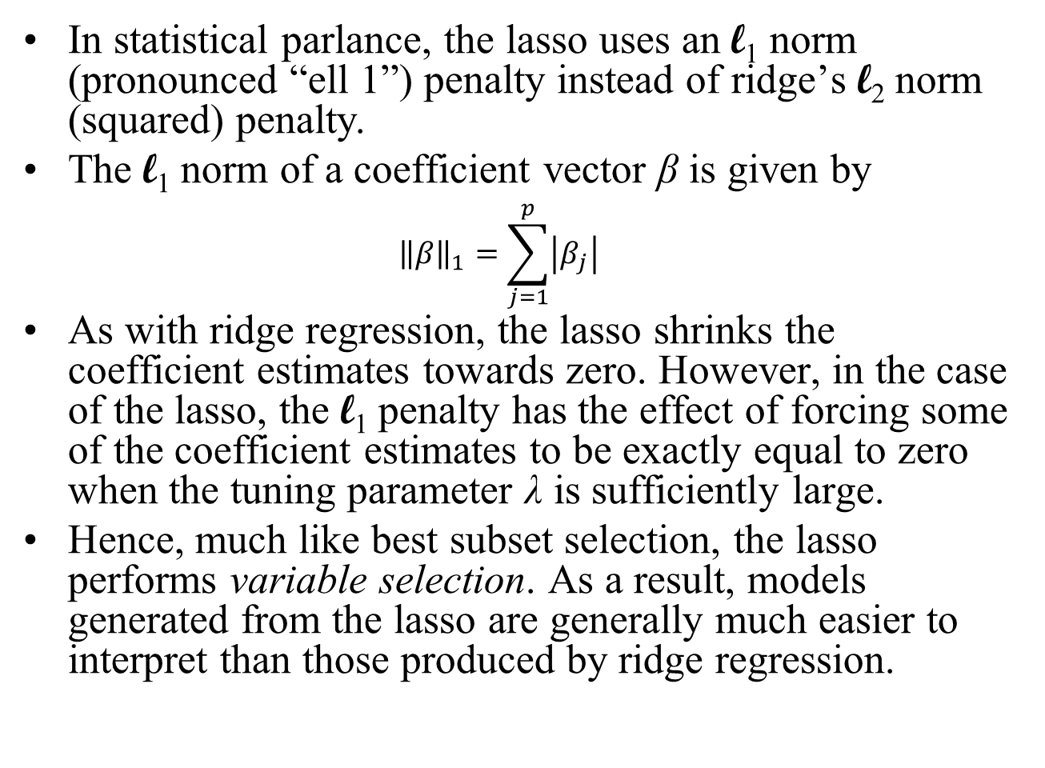
The Lasso
In statistical parlance, the lasso uses an l₁ norm (pronounced “ell 1”) penalty instead of ridge’s l₂ norm (squared) penalty.
The l₁ norm of a coefficient vector β is given by ${\left\|β\right\|}_{1}=\sum_{j=1}^{p}{\left|β_{j}\right|}$
As with ridge regression, the lasso shrinks the coefficient estimates towards zero. However, in the case of the lasso, the l₁ penalty has the effect of forcing some of the coefficient estimates to be exactly equal to zero when the tuning parameter λ is sufficiently large.
Hence, much like best subset selection, the lasso performs variable selection. As a result, models generated from the lasso are generally much easier to interpret than those produced by ridge regression.

Slide 22
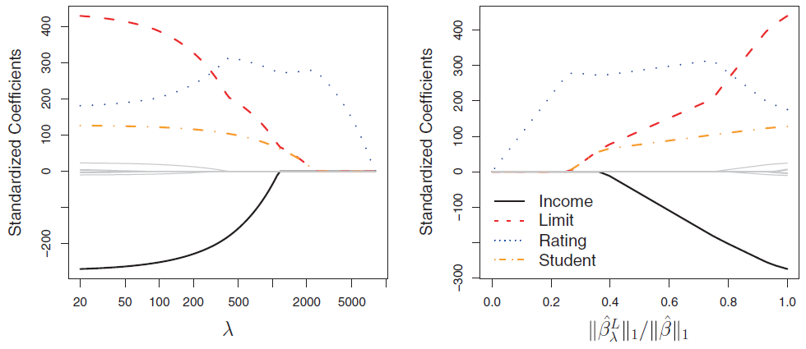
The Lasso: An Example
As with ridge regression, then λ = 0, the lasso simply gives the least squares fit, and when λ becomes sufficiently large, the lasso gives the null model in which all coefficient estimates equal zero.
However, in between these two extremes, the ridge regression and lasso models are quite different. Moving from left to right in the right-hand figure, we observe that at first the lasso results in a model that contains only the rating predictor.
Then student and limit enter the model almost simultaneously, shortly followed by income. Eventually, the remaining variables enter the model.
Hence, depending on the value of λ, the lasso can produce a model involving any number of variables.
In contrast, ridge regression will always include all of the variables in the model.

Slide 23
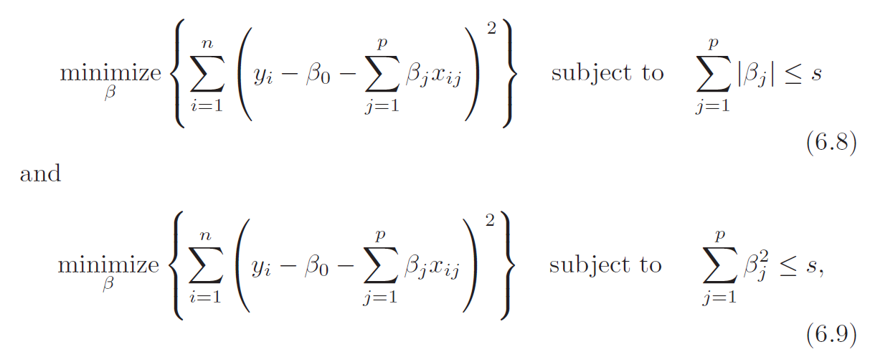
Another Formulation for Ridge Regression and the Lasso
One can show that the lasso and ridge regression coefficient estimates solve the problems
That is, there is some s such that for every value of λ, these equations will give the same lasso coefficient estimates as our earlier expressions for ridge regression and the lasso .
Similarly, for every value of λ there is a corresponding s such that our earlier expressions will give the same ridge regression coefficient estimates as the expressions above.
for lasso regression, and for ridge,

Slide 24
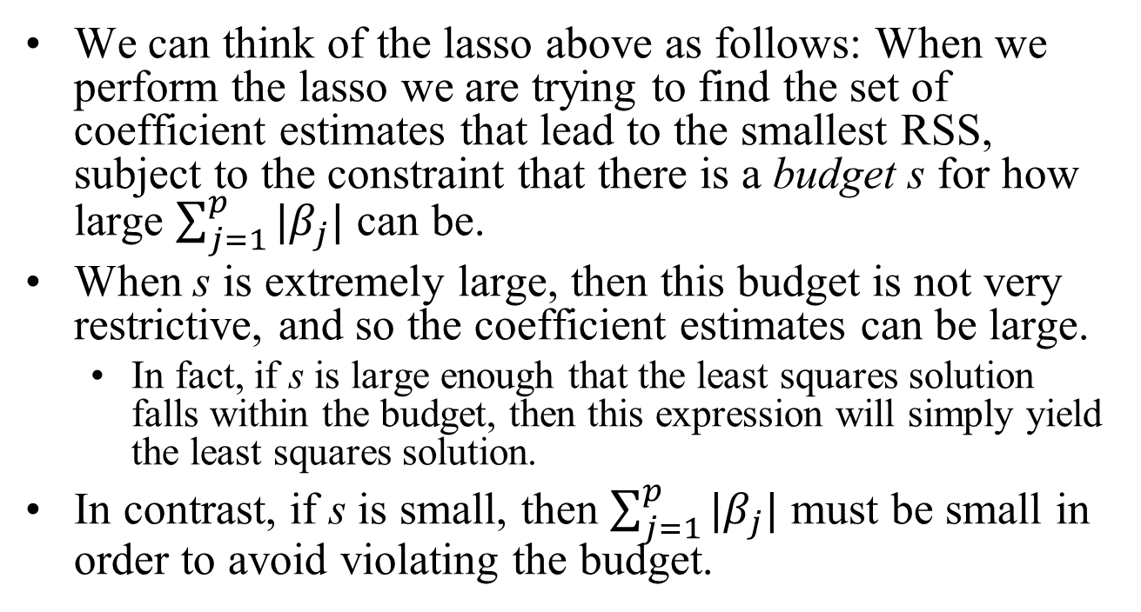
Another Formulation for Ridge Regression and the Lasso
We can think of the lasso above as follows: When we perform the lasso we are trying to find the set of coefficient estimates that lead to the smallest RSS, subject to the constraint that there is a budget s for how large $\sum_{j=1}^{p}{|β_{j}|}$ can be.
When s is extremely large, then this budget is not very restrictive, and so the coefficient estimates can be large.
In fact, if s is large enough that the least squares solution falls within the budget, then this expression will simply yield the least squares solution.
In contrast, if s is small, then $\sum_{j=1}^{p}{|β_{j}|}$ must be small in order to avoid violating the budget.

Slide 25
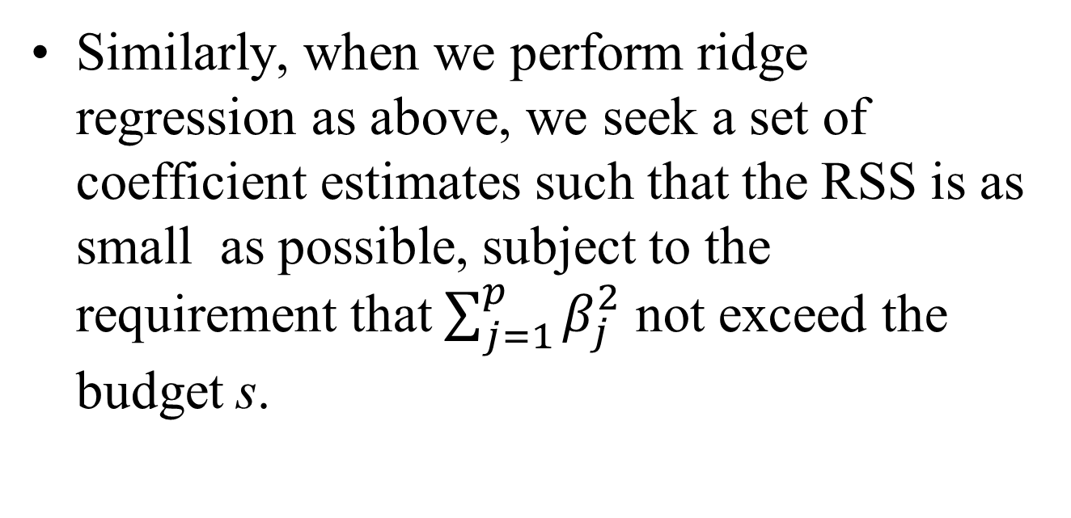
Another Formulation for Ridge Regression and the Lasso
Similarly, when we perform ridge regression as above, we seek a set of coefficient estimates such that the RSS is as small as possible, subject to the requirement that $\sum_{j=1}^{p}{β_{j}^{2}}$ not exceed the budget s.

Slide 26
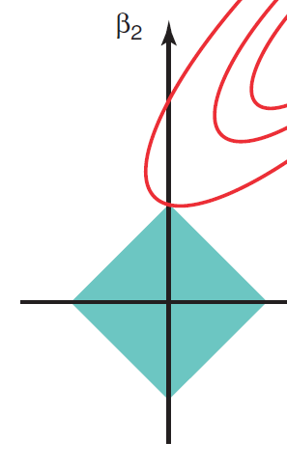
Another Formulation for Ridge Regression and the Lasso
When p = 2, then the above expression indicates that the lasso coefficient estimates have the smallest RSS out of all points that lie within the diamond defined by |β₁|+|β₂| ≤ s.
β₂
(0, s)
β₁
(-s, 0)
(s, 0)
(0, -s)

Slide 27

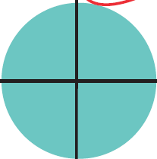
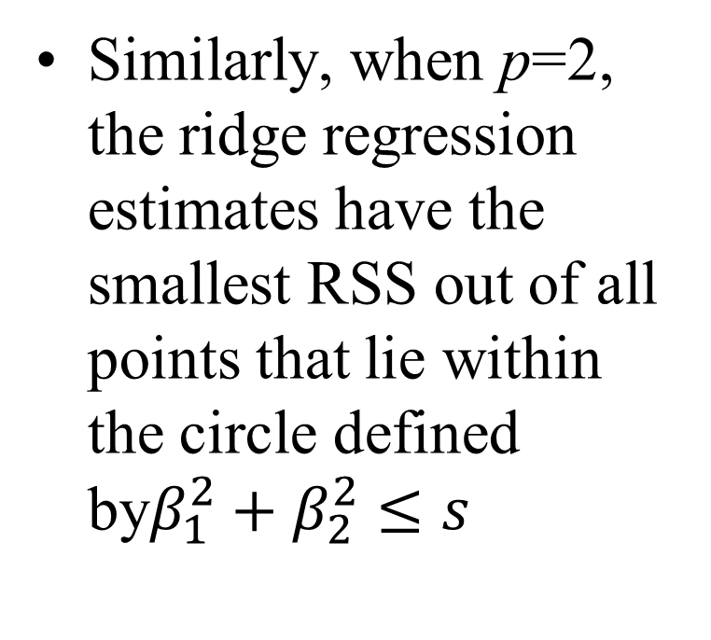
Another Formulation for Ridge Regression and the Lasso
Similarly, when p=2, the ridge regression estimates have the smallest RSS out of all points that lie within the circle defined by$β_{1}^{2}+β_{2}^{2}≤s$
β₂
(0, s)
β₁
(-s, 0)
(s, 0)
(0, -s)

Slide 28
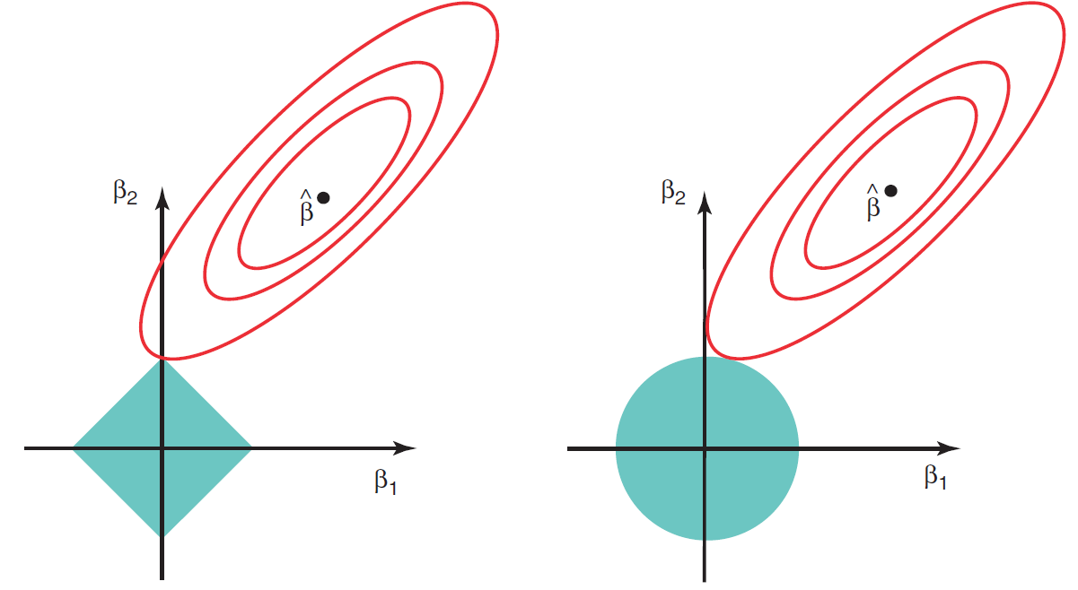
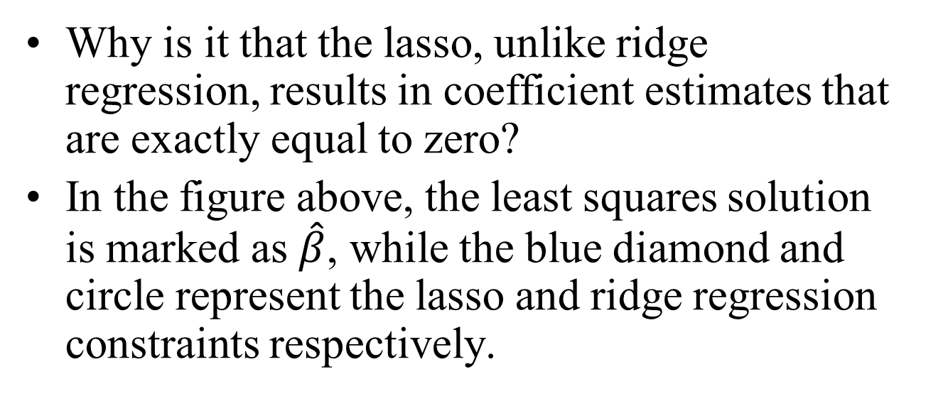
The Variable Selection Property of the Lasso
(0, s)
(0, s)
(-s, 0)
(s, 0)
(-s, 0)
(s, 0)
(0, -s)
(0, -s)
Why is it that the lasso, unlike ridge regression, results in coefficient estimates that are exactly equal to zero?
In the figure above, the least squares solution is marked as $\hat{β}$, while the blue diamond and circle represent the lasso and ridge regression constraints respectively.

Slide 29
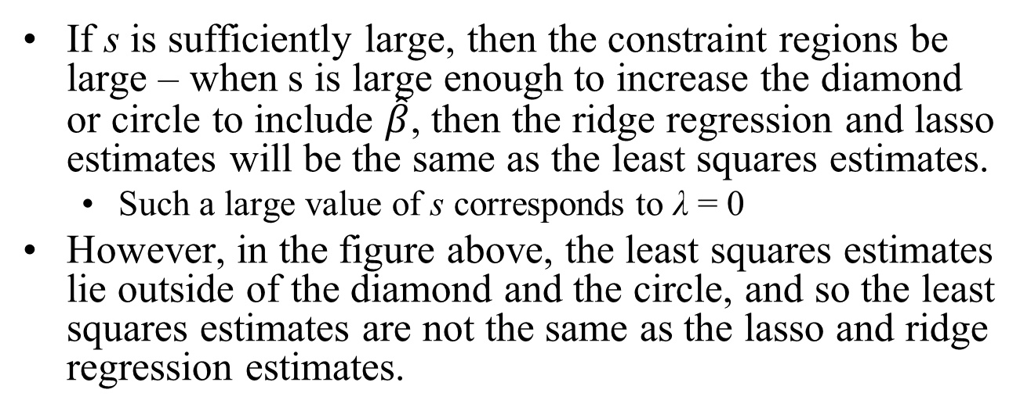
The Variable Selection Property of the Lasso
(0, s)
(0, s)
(-s, 0)
(s, 0)
(-s, 0)
(s, 0)
(0, -s)
(0, -s)
If s is sufficiently large, then the constraint regions be large – when s is large enough to increase the diamond or circle to include $\hat{β}$, then the ridge regression and lasso estimates will be the same as the least squares estimates.
Such a large value of s corresponds to λ = 0
However, in the figure above, the least squares estimates lie outside of the diamond and the circle, and so the least squares estimates are not the same as the lasso and ridge regression estimates.

Slide 30
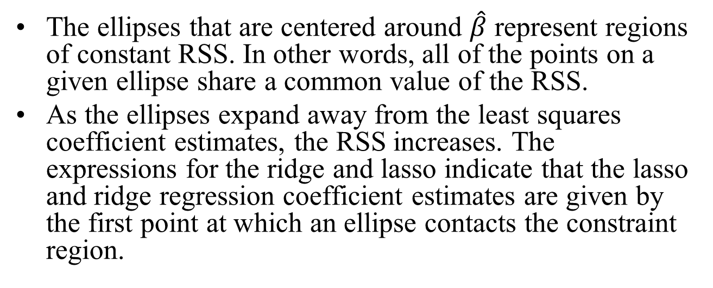
The Variable Selection Property of the Lasso
(0, s)
(0, s)
(-s, 0)
(s, 0)
(-s, 0)
(s, 0)
(0, -s)
(0, -s)
The ellipses that are centered around $\hat{β}$ represent regions of constant RSS. In other words, all of the points on a given ellipse share a common value of the RSS.
As the ellipses expand away from the least squares coefficient estimates, the RSS increases. The expressions for the ridge and lasso indicate that the lasso and ridge regression coefficient estimates are given by the first point at which an ellipse contacts the constraint region.

Slide 31
The Variable Selection Property of the Lasso
(0, s)
(0, s)
(-s, 0)
(s, 0)
(-s, 0)
(s, 0)
(0, -s)
(0, -s)
Since ridge regression has a circular constraint with no sharp points, this intersection will not generally occur on an axis, and so the ridge regression coefficient estimates will be exclusively non-zero.
However, the lasso constraint has corners at each of the axes, and so the ellipse will often intersect the constraint region at an axis.
When this occurs, one of the coefficients will equal zero (see the coordinate values of the corners above).
In this case, the intersection occurs at β₁ = 0, and so the resulting model will only include β₂.

Slide 32
The Variable Selection Property of the Lasso
(0, s)
(0, s)
(-s, 0)
(s, 0)
(-s, 0)
(s, 0)
(0, -s)
(0, -s)
In higher dimensions, many of the coefficient estimates may equal zero simultaneously.
Here, we considered the simple case of p = 2. When p = 3, then the constraint region for ridge regression becomes a sphere, and the constraint region for the lasso becomes a polyhedron.
When p > 3, the constraint for ridge regression becomes a hypersphere, and the constraint for the lasso becomes a polytope.
However, the key ideas depicted here still hold. In particular, the lasso leads to feature selection when p > 2 due to the sharp corners of the polyhedron or polytope.

Slide 33
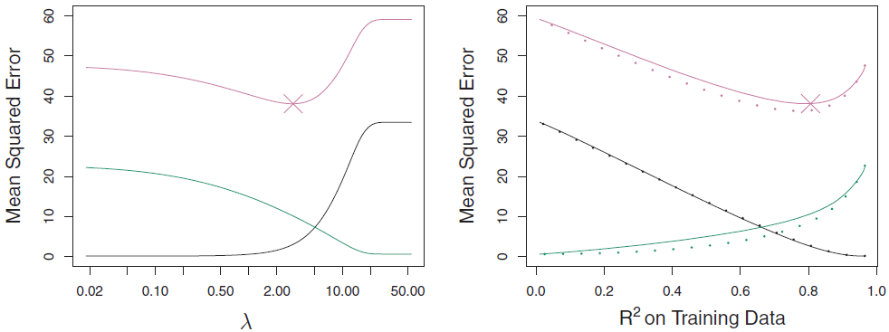
Comparing the Lasso and Ridge Regression
Squared bias (black) Variance (green)
Test MSE (purple)
It is clear that the lasso has a major advantage over ridge regression, in that it produces simpler and more interpretable models that involve only a subset of the predictors. However, which method leads to better prediction accuracy?
The left-hand panel above displays the variance, squared bias, and test MSE of the lasso applied to the same simulated data as displayed earlier for ridge regression.
Note that the lasso leads to qualitatively similar behavior when compared to ridge regression, in that as λ increases, the variance decreases and the bias increases.

Slide 34
Comparing the Lasso and Ridge Regression
Squared bias (black) Variance (green)
Test MSE (purple)
Dotted line: Ridge
Solid line: Lasso
In the right-hand panel, the dotted lines represent the ridge regression fits. Here we plot both against their R² on the training data.
This is another useful way to index models, and can be used to compare models with different types of regularization, as is the case here.
In this example, the lasso and ridge regression result in almost identical biases. However, the variance of ridge regression is slightly lower than the variance of the lasso.
Consequently, the minimum MSE of ridge regression is slightly smaller than that of the lasso.

Slide 35
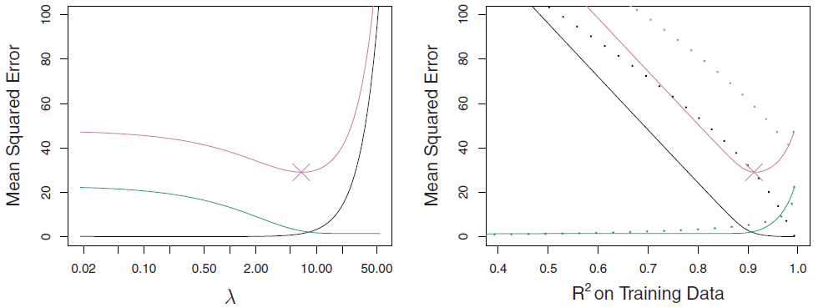
Comparing the Lasso and Ridge Regression
Bias
Squared bias (black) Variance (green)
Test MSE (purple)
MSE
Dotted line: Ridge
Solid line: Lasso
Variance
However, the previous dataset was generated in such a way that all 45 predictors were related to the response - that is, none of the true coefficients β₁, . . . , β₄₅ equaled zero.
The lasso implicitly assumes that a number of the coefficients truly equal zero. Consequently, it is not surprising that ridge regression outperforms the lasso in terms of prediction error in this setting.
The figure above illustrates a similar situation, except that now the response is a function of only 2 out of 45 predictors.
Now the lasso tends to outperform ridge regression in terms of bias, variance, and MSE.

Slide 36
Comparing the Lasso and Ridge Regression
These two examples illustrate that neither ridge regression nor the lasso will universally dominate the other.
In general, one might expect the lasso to perform better in a setting where a relatively small number of predictors have substantial coefficients, and the remaining predictors have coefficients that are very small or that equal zero.
Ridge regression will perform better when the response is a function of many predictors, all with coefficients of roughly equal size.
However, the number of predictors that is related to the response is never known a priori for real data sets. A technique such as cross-validation can be used in order to determine which approach is better on a particular data set.

Slide 37
Selecting the Tuning Parameter
Just as the subset selection approaches require a method to determine which of the models under consideration is best, implementing ridge regression and the lasso requires a method for selecting a value for the tuning parameter λ.
Cross-validation provides a simple way to tackle this problem. We choose a grid of λ values, and compute the cross-validation error for each value of λ.
We then select the tuning parameter value for which the cross-validation error is smallest.
Finally, the model is re-fit using all of the available observations and the selected value of the tuning parameter.

Slide 38
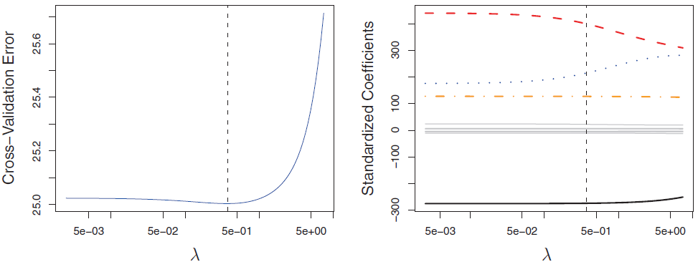
Selecting the Tuning Parameter
The left-hand figure above displays the choice of λ that results from performing leave-one-out cross validation on the ridge regression fits from the Credit data set. The dashed vertical line indicates the selected value of λ.
The right-hand figure displays the coefficient estimates as a function of λ, with the vertical dashed line indicating the value of λ selected by cross-validation.
In this case the optimal value of λ is relatively small, indicating that the associated fit only involves a small amount of shrinkage relative to the least squares solution.
In addition, the dip is not very pronounced, so there is rather a wide range of values that would give very similar error.
In a case like this we might simply use the least squares solution.

Slide 39
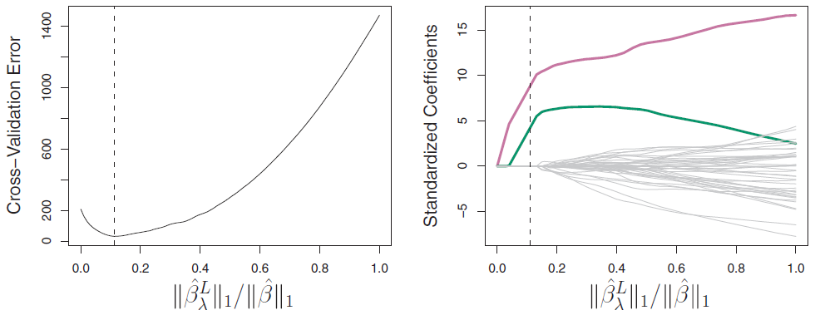
Selecting the Tuning Parameter
The figure above provides an illustration of ten-fold cross-validation applied to the lasso fits on the sparse simulated data from an earlier example where the response is a function of only 2 out of 45 predictors.
The left-hand panel displays the cross-validation error, while the right-hand panel displays the coefficient estimates.
The vertical dashed lines indicate the point at which the cross-validation error is smallest.
The two colored lines in the right-hand panel represent the two predictors that are related to the response, while the grey lines represent the unrelated predictors.
These are often referred to as signal and noise variables, respectively.

Slide 40
Selecting the Tuning Parameter
Not only has the lasso correctly given much larger coefficient estimates to the two signal predictors, but also the minimum cross validation error corresponds to a set of coefficient estimates for which only the signal variables are non-zero.
Hence cross validation together with the lasso has correctly identified the two signal variables in the model, even though this is a challenging setting, with p = 45 variables and only n = 50 observations.
In contrast, the least squares solution - displayed on the far right of the right-hand panel assigns a large coefficient estimate to only one of the two signal variables.

Slide 41
See The Lasso section in RidgeRegressionAndTheLasso.R

